Slide 1
Web Development Let’s Break It Down
Scott Beslow
General Assembly - Chicago
January 5, 2016

Slide 2
Scott Beslow
Email: scott.beslow@gmail.com
LinkedIn: linkedin.com/in/scottbeslow
Twitter: @sbeslow
GitHub: sbeslow

Slide 3
Let’s Break It Down
The ABC’s of web programming
Conceptual, not practical
We’re going to build a website together
Demo, not workshop
Stop me and ask questions

Slide 4
By the end of this class
Understand your dorky coworkers
Have a better idea if coding is something you’d like to pursue further and how
Have the tools to play with our demo

Slide 5
GitHub – Build software together
http://www.github.com
A place to store and share the code
Open-source: Freely available
Graphic interface for git
Track code changes over time and by developer
BitBucket (five free private repos)
Notes:
CREATE AN ACCOUNT HERE

Slide 6
What happens (behind the scenes), when we visit Amazon?
Notes:
How do we interact with the internet?
On what devices – laptops, desktops, tablets, smartphones
What do we do on it?
Let’s pick a website.

Slide 7
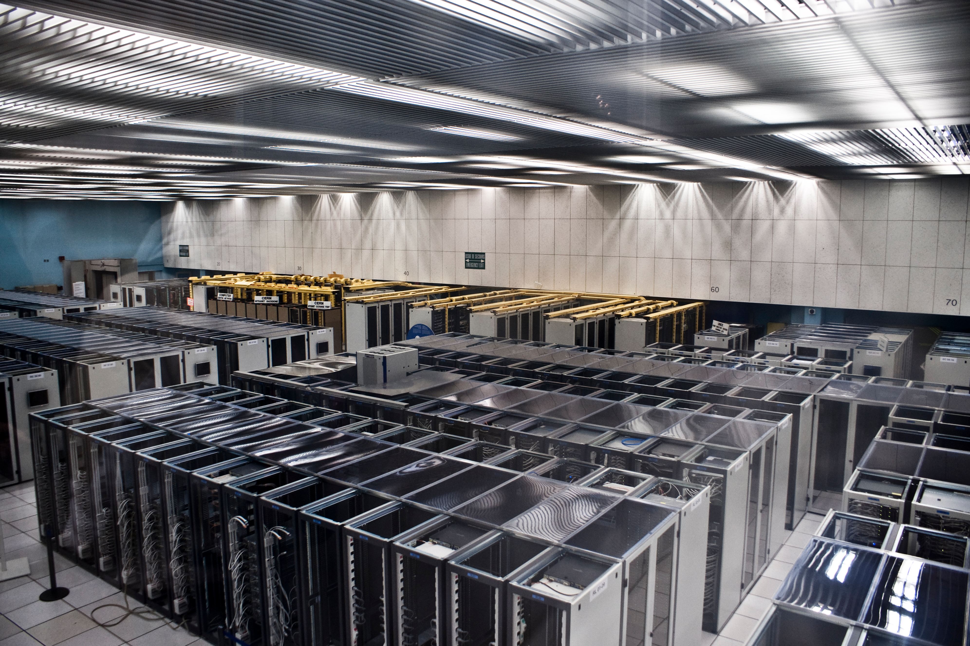

Slide 8
Databases
An organized collection of data
We want to search through large amounts of data (you might even say big data) in a short period of time
How we want to access data determines how we want to store data

Slide 9
Comparing Databases
Name | Use Case
MySQL/Postgress | Flexible, easy, popular for set datasets. Think data tables
MongoDb | Unstructured data
Neo4j | Graph database – focuses on the relationships between data
CouchDb | Can work with frequent network unavailability
HBase | Huge datasets

Slide 10
Solving the same problem with many languages
Front End
Back End
HTML
CSS
Javascript
Objective C/Swift (iOS)
Java (Android)
PHP (Wordpress)
Python
Ruby
Java
C#
Javascript
Notes:
Front end – you’ll see that these three languages run in conjunction
Back end – small programs will usually be written in one of these. Big corporations though, have several back end servers running
Is there a best language? Depends on who you ask.

Slide 11
(Twitter) Bootstrap
A framework for developing responsive, mobile first projects on the web
http://www.getbootstrap.com

Slide 12
IDE
An integrated development environment is a program that you write code in (The MS Word of coding).
We’re going to use Brackets.io

Slide 13
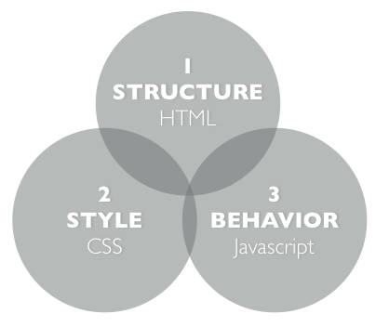

Slide 14
Data Retrieval
API – Application Programming Interface
RESTful API – Representational State Transfer
JSON – Javascript Object Notation
AJAX – Asynchronous Javascript and XML
Notes:
Introduce our sample dataset

Slide 15
Pushing to the web
Github hosts web pages for free
http://[username].github.io/[repoName]
git checkout --orphan gh-pages

Slide 16
Our Design Pattern
Database
Restaurants
Webpage rendering
Code to show webpage on client
Web Server
Sending data through API
Parsing out per restaurant

Slide 17
MVC Framework
Model Database
Food Inspection reports
View Webpage rendering
Code to show webpage on client
HTML, CSS, Javascript
Controller Web Server Controller
Sending data through API
Parsing out per restaurant

Slide 18
Common MVC Frameworks
A single application that covers all three M-V-C components
Spring, Play! Framework (Java)
ASP .NET (C#)
Django (Python)
Ruby On Rails (Ruby)
Nodejs (Javascript)

Slide 19
Next Steps
Look at code, handouts from the repo at https://github.com/sbeslow/
Create a GitHub account
Install git or the GitHub app
https://windows.github.com
https://mac.github.com
Clone the repo on your machine and play around

Slide 20
Potential Projects
Make it look nice
Include search by address
Show a map (HINT: use Javascript library)
Display data from other projects from the Open Data Portal
Or look around for other APIs

Slide 21
Other Places to Learn
W3 Schools
Codecademy
StackOverflow
CodePen
Dash (General Assembly)

Slide 22
Upcoming Web Development Courses
Web Development Full-Time Immersive
- Monday-Friday, 9am-5pm, beginning February 16th. Designed for people interested in changing careers into becoming web developers. In this course, students will learn front-end and back-end coding skills, and we provide rigorous career support. Over 90% of grads from this program get employed in web development within 3 months of graduating.

Slide 23
Upcoming Web Development Courses
Front-End Web Development Part-Time Course
- Tuesdays & Thursdays, 6-9pm, beginning February 18th. In this 10-week course, students learn how to build beautiful, interactive websites using HTML, CSS and JavaScript.
If interested and want more information, please email christa@generalassemb.ly

Slide 24
Questions?

